Slide 1
Power BI Part - II
Visuals List

Slide 2
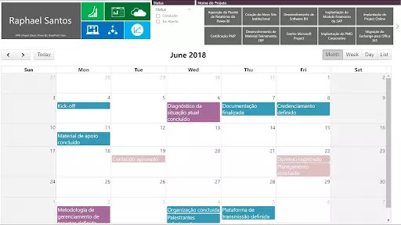
18. Calendar Charts
The calendar charts are unique charts and allow you to represent the distribution of values across a calendar. The custom calendar supports one data field and many measurable columns that are necessary for your project.

Slide 3
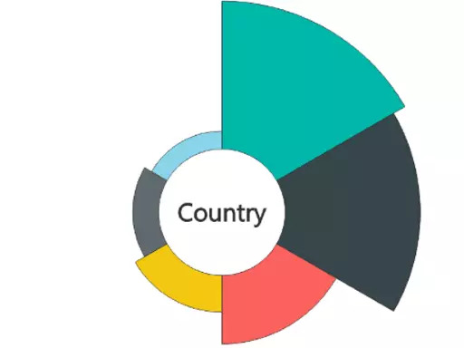
19. Aster Plot
Aster plot charts are similar to pie charts and doughnut charts. In the aster plot, you can be able to visualize up to two measures. The first measure controls the depth and the second measure controls the width of each section.

Slide 4
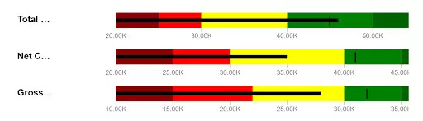
20. Bullet Charts
Bullet charts are the replacement of dashboard gauges and meters. They are useful to compare one or more measures to enrich the data. Bullet charts may be vertical, horizontal and may be stacked to allow the comparison of the data.

Slide 5
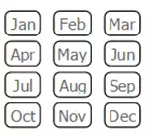
21. Chiclet Slicer
Chiclet Slicer is similar to the slicer and it is made of buttons. It has a lot more flexibility and includes the ability to use images instead of text as filters.

Slide 6
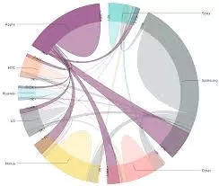
22. Chord
Chord diagram provides an easy way to identify the interrelationship data visualization in a matrix. A circular chart shows the relationship between the variables, and it connects the data points in the form of an arc in the chord chart.

Slide 7
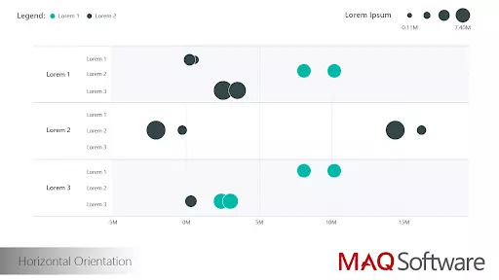
23. Dot plot
A dot plot chart is similar to the scatter chart and bubble chart, and it allows you to compare multiple measures by their magnitudes and represent the data with the dot. It also allows you to plot the data along the x-axis.

Slide 8
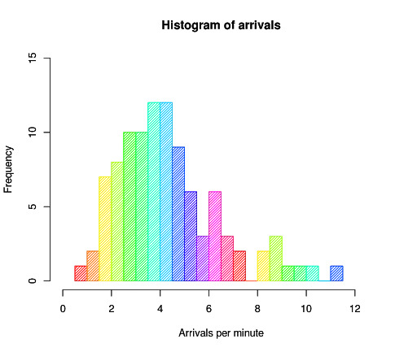
24. Histogram
A histogram chart is similar to a column chart, and it visualizes the distribution of data over a certain time. Each bar in the histogram shows the frequency at each interval.

Slide 9
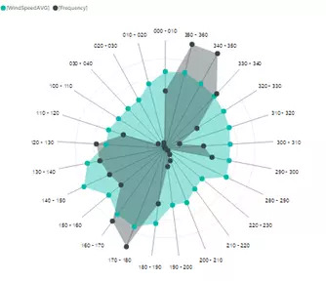
25. Radar Chart
A radar chart is a graphical chart to display various types of data in the form of two-dimensional charts. It compares two or more variables to display on the axes starting from the point. Stream Graph: A stream graph is a type of stacked graph which represents data around the central axis, it shows the changes in the data over a certain time through a flowing, organic shape that resembles a river-like stream.

Slide 10
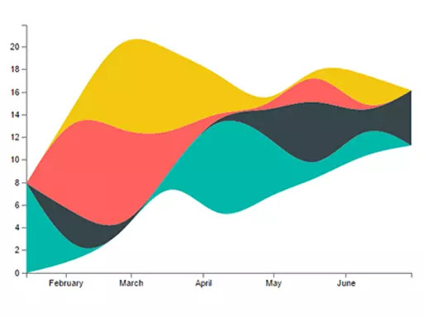
26. Stream Graph
A stream graph is a type of stacked graph which represents data around the central axis, it shows the changes in the data over a certain time through a flowing, organic shape that resembles a river-like stream.

Slide 11
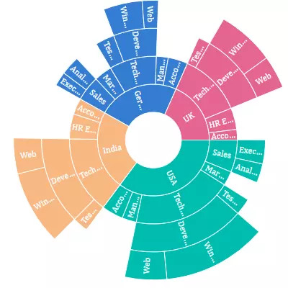
27. Sunburst
The sunburst chart is also called a multi-level pie chart, radial treemap, and ring chart which is used to visualize the typical hierarchical data. It consists of inner circles surrounded by rings of deeper hierarchy levels. The angle of each part is divided equally under its parent node.

Slide 12
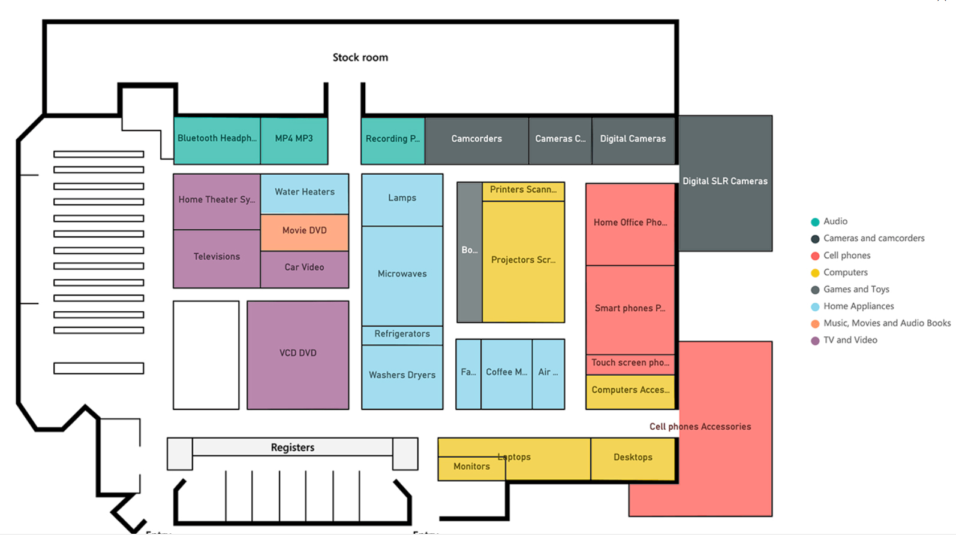
28. Synoptic Panel
The synoptic panel allows you to present one or more images, assigning an arbitrary area. These areas are colored and highlighted to display the information.

Slide 13
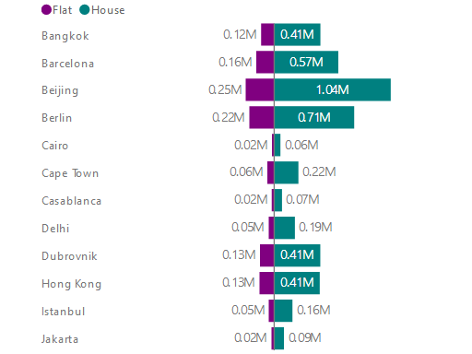
29. Tornado
Tornado charts are useful to analyze the sensor data compared to the relative variables. These charts are also called tornado charts or plots and a special type of bar chart.

Slide 14
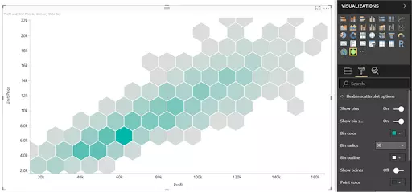
30. Hexbin Scatter Plot
Hexbin scatters plot is a custom visual effect for Microsoft Power BI that displays the points on the top of hexagonal bins.

Slide 15
31. KPI
KPI or Key Performance Indicator is a measure for businesses to understand how they perform in a specific area that is important and many times critical for their business. For example, they would like to see how the current year-to-date sales are going against what they estimated? Is it higher or lower? What is the trend? Is it going upward or downward? There are some visualization options to show KPIs, and from them, the most commons are; Gauges, Charts with arrows that show upward or downward, and color codes of red, amber, or green (visualizing the status).
KPI Elements
Value : The main measure which we want to evaluate
Target : What we want to compare the Value with
Trend : How Value performs in a time period, is it going upward, downward…?
Status : What is the current status of Value against Target?

